Slide 1
Multithreading in Java

Slide 2
Multithreading in Java
Multithreading in java is a process of executing multiple threads simultaneously.
Thread is basically a lightweight sub-process, a smallest unit of processing. Multiprocessing and multithreading, both are used to achieve multitasking.
But we use multithreading than multiprocessing because threads share a common memory area. They don't allocate separate memory area so saves memory, and context-switching between the threads takes less time than process.
Java Multithreading is mostly used in games, animation etc.

Slide 3
Advantage of Java Multithreading
1) It doesn't block the user because threads are independent and you can perform multiple operations at same time.
2) You can perform many operations together so it saves time.
3) Threads are independent so it doesn't affect other threads if exception occur in a single thread.

Slide 4
Multitasking
Multitasking is a process of executing multiple tasks simultaneously. We use multitasking to utilize the CPU. Multitasking can be achieved by two ways:
Process-based Multitasking(Multiprocessing)
Thread-based Multitasking(Multithreading)

Slide 5
1) Process-based Multitasking (Multiprocessing)
Each process have its own address in memory i.e. each process allocates separate memory area.
Process is heavyweight.
Cost of communication between the process is high.
Switching from one process to another require some time for saving and loading registers, memory maps, updating lists etc.

Slide 6
2) Thread-based Multitasking (Multithreading)
Threads share the same address space.
Thread is lightweight.
Cost of communication between the thread is low.

Slide 7
What is Thread in java
A thread is a lightweight sub process, a smallest unit of processing. It is a separate path of execution.
Threads are independent, if there occurs exception in one thread, it doesn't affect other threads. It shares a common memory area.

Slide 8
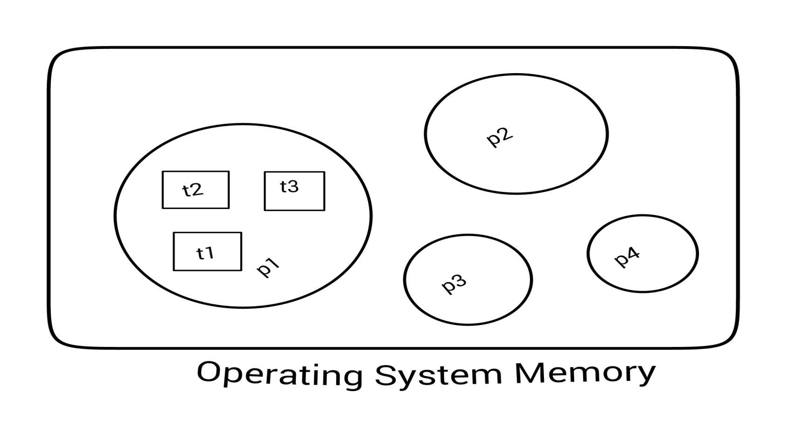
As shown in the above figure, thread is executed inside the process. There is context-switching between the threads. There can be multiple processes inside the OS and one process can have multiple threads.

Slide 9
Life cycle of a Thread (Thread States)
A thread can be in one of the five states. According to sun, there is only 4 states in thread life cycle in java new, runnable, non-runnable and terminated. There is no running state.
But for better understanding the threads, we are explaining it in the 5 states.
The life cycle of the thread in java is controlled by JVM. The java thread states are as follows:
New
Runnable
Running
Non-Runnable (Blocked)
Terminated

Slide 10
Thread State Diagram
Alive
Running
new CounterThread1(max);
while (…) { … }
New Thread
Runnable
Dead Thread
cntThread.start();
run() method returns
Blocked
Object.wait()
Thread.sleep()
blocking IO call
waiting on a monitor

Slide 11
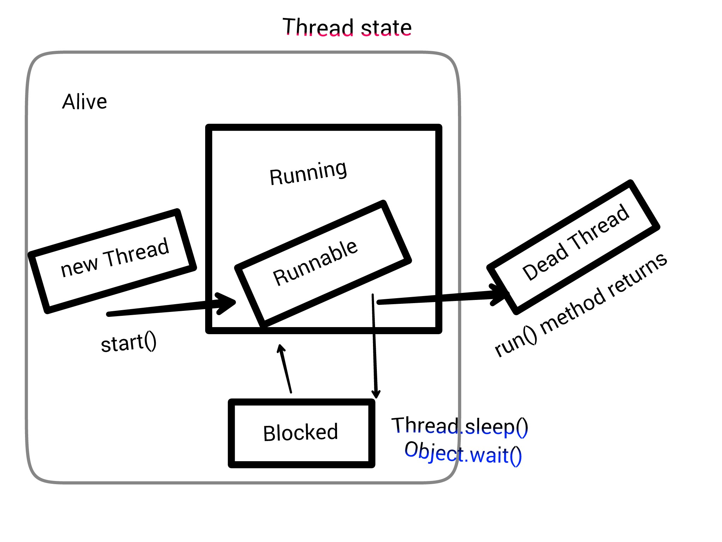

Slide 12
1) New
The thread is in new state if you create an instance of Thread class but before the invocation of start() method.
2) Runnable
The thread is in runnable state after invocation of start() method, but the thread scheduler has not selected it to be the running thread.
3) Running
The thread is in running state if the thread scheduler has selected it.
4) Non-Runnable (Blocked)
This is the state when the thread is still alive, but is currently not eligible to run.
5) Terminated
A thread is in terminated or dead state when its run() method exits.

Slide 13
How to create thread
There are two ways to create a thread:
By extending Thread class
By implementing Runnable interface.

Slide 14
Thread class:
Thread class provide constructors and methods to create and perform operations on a thread.Thread class extends Object class and implements Runnable interface.

Slide 15
Commonly used Constructors of Thread class:
Thread()
Thread(String name)
Thread(Runnable r)
Thread(Runnable r,String name)

Slide 16
Commonly used methods of Thread class:
public void run(): is used to perform action for a thread.
public void start(): starts the execution of the thread.JVM calls the run() method on the thread.
public void sleep(long miliseconds): Causes the currently executing thread to sleep (temporarily cease execution) for the specified number of milliseconds.
public void join(): waits for a thread to die.
public void join(long miliseconds): waits for a thread to die for the specified miliseconds.
public int getPriority(): returns the priority of the thread.
public int setPriority(int priority): changes the priority of the thread.
public String getName(): returns the name of the thread.
public void setName(String name): changes the name of the thread.
public Thread currentThread(): returns the reference of currently executing thread.
public int getId(): returns the id of the thread.
public Thread.State getState(): returns the state of the thread.
public boolean isAlive(): tests if the thread is alive.
public void yield(): causes the currently executing thread object to temporarily pause and allow other threads to execute.
public void suspend(): is used to suspend the thread(depricated).
public void resume(): is used to resume the suspended thread(depricated).
public void stop(): is used to stop the thread(depricated).
public boolean isDaemon(): tests if the thread is a daemon thread.
public void setDaemon(boolean b): marks the thread as daemon or user thread.
public void interrupt(): interrupts the thread.
public boolean isInterrupted(): tests if the thread has been interrupted.
public static boolean interrupted(): tests if the current thread has been interrupted.

Slide 17
Thread Scheduler in Java
Thread scheduler in java is the part of the JVM that decides which thread should run.
There is no guarantee that which runnable thread will be chosen to run by the thread scheduler.
Only one thread at a time can run in a single process.
The thread scheduler mainly uses preemptive or time slicing scheduling to schedule the threads.

Slide 18
Difference between preemptive scheduling and time slicing
Under preemptive scheduling, the highest priority task executes until it enters the waiting or dead states or a higher priority task comes into existence. Under time slicing, a task executes for a predefined slice of time and then reenters the pool of ready tasks. The scheduler then determines which task should execute next, based on priority and other factors.

